Slide 1
Quantum Computing
An Introduction from a Layman’s Perspective
Matthew K Brown, P.E., MBA

Slide 2
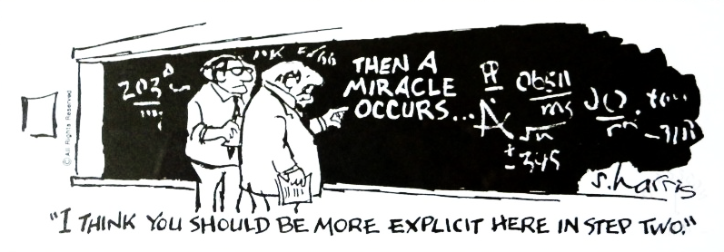
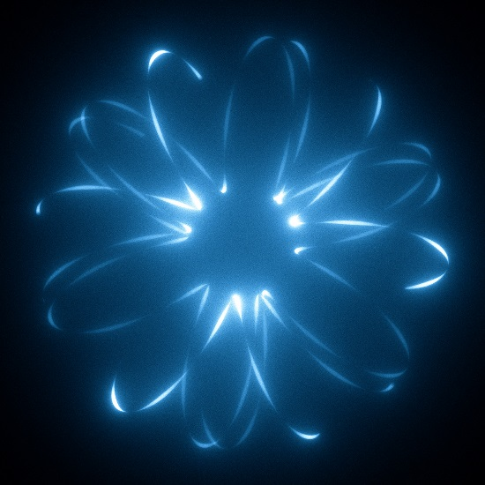

Mainstream Sales Pitch Storyline

Slide 3
Content
Part 1 – What’s under the hood?
Part 2 – What is the state of the tech?
Qubits
Quantum Computers
Quantum Circuits
Quantum Gates
First Quantum Circuit
Entanglement
Hardware
Software
Applications
Key Players
Example – IBM Cloud
Key Takeaways

Slide 4
Qubits
The qubit is a single unit of quantum information analogous to a classical computer bit
Unlike a classical bit, a qubit can “exist in more than one state.” This is known as superposition.
More accurately, a qubit exists in a complex state that we cannot directly observe without collapsing the qubit into a real dimension
When the qubit is measured, it must assume one real state or the other
A qubit is physically implemented with a two-state quantum particle
A qubit is described by the probability of assuming one of the two states

Slide 5
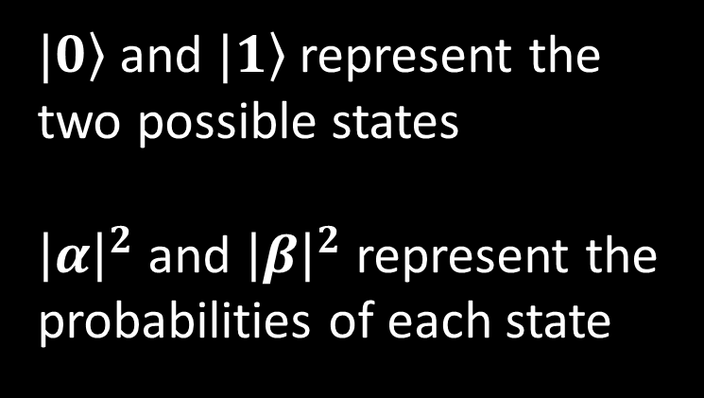






Qubits – A Mathematical Representation
$|\left.0\right\rangle$ and $|\left.1\right\rangle$ represent the
two possible states
${\left|α\right|}^{2}$ and ${\left|β\right|}^{2}$ represent the probabilities of each state
$$|\left.0\right\rangle$$
$$α$$
$$|\left.1\right\rangle$$
$$\left|\left.ψ\right\rangle =α\right|\left.0\right\rangle +β|\left.1\right\rangle = \left[\begin{matrix}α \\ β\end{matrix}\right]$$
$$β$$
$${\left|α\right|}^{2}+{\left|β\right|}^{2}=1$$

Slide 6
Quantum Computers
A quantum computer performs operations on qubits
The sequence of operations create a quantum circuit
A circuit amounts to a programmable linear algebra processor that exhibits some really unique behavior in the physical world
Much like the early days of digital computing, most of the computer is technology that supports a quantum “processor”
Analogies: Math Co-Processor, Digital Signal Processor, Field Programmable Gate Array

Slide 7
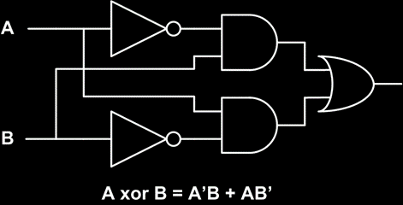
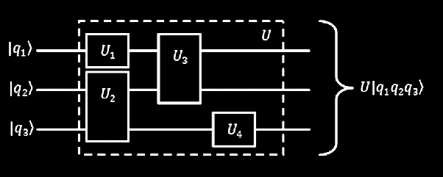
Quantum Circuits
Quantum circuits are analogous to logic circuits, but not identical
Circuits are a combination of gates that perform some function

Slide 8

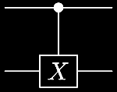






Quantum Circuits – Symbolic Representations
Qubits
Gates
Measure
$$|\left.ψ\right\rangle$$
$$|\left.q\right\rangle$$
$$|\left.0\right\rangle$$
$$|\left.1\right\rangle$$
*Dirac Notation

Slide 9
Quantum Gates
Quantum gates are the building block of quantum circuits and represent the operations that can be performed on qubits.
All gates can be described as a Unitary Matrix
Unlike measuring a qubit, gates can perform operations without collapsing its superposition into a single state
This is where the world as we know it gets weird.

Slide 10


Quantum Gates
Hadamard (H-Gate)
Controlled NOT (CNOT, cX-Gate)
$$\left[\begin{matrix}\begin{matrix}1 & 0 \\ 0 & 1\end{matrix} & \begin{matrix}0 & 0 \\ 0 & 0\end{matrix} \\ \begin{matrix}0 & 0 \\ 0 & 0\end{matrix} & \begin{matrix}0 & 1 \\ 1 & 0\end{matrix}\end{matrix}\right]$$
$$\frac{1}{\sqrt{2}}\left[\begin{matrix}1 & 1 \\ 1 & −1\end{matrix}\right]$$

Slide 11







First Quantum Circuit – Random # Generator
$$|\left.0\right\rangle$$
$$|\left.ψ\right\rangle$$
$$\left|\left.ψ\right\rangle =H\right|\left.0\right\rangle$$
$$|\left.ψ\right\rangle =\frac{1}{\sqrt{2}}\left[\begin{matrix}1 \\ 0\end{matrix}\right]\left[\begin{matrix}1 & 1 \\ 1 & −1\end{matrix}\right]$$
$$\left.\left|ψ\right.\right\rangle =\left[\begin{matrix}0.707 \\ 0.707\end{matrix}\right]=\left.0.707\left|0\right.\right\rangle +0.707|\left.1\right\rangle$$
$$P\left(\left.|\left.ψ\right\rangle =\left|0\right.\right\rangle \right)={\left|0.707\right|}^{2}=50\%$$
$$P\left(\left.|\left.ψ\right\rangle =\left|1\right.\right\rangle \right)={\left|0.707\right|}^{2}=50\%$$

Slide 12





Entanglement
Entanglement is a phenomenon where the state of a pair of quantum particles cannot be described independently. This is what Einstein refers to a “spooky action.”
$$|\left.q_{0}\right\rangle$$
$$|\left.ψ_{0}\right\rangle$$
$$|\left.q_{1}\right\rangle$$
$$|\left.ψ_{1}\right\rangle$$
$$f\left({\left.|q_{0}q_{1}\right\rangle }_{00}\right)=|\left.ψ_{0}ψ_{1}\right\rangle =\frac{\left.|00\right\rangle +\left.|11\right\rangle }{\sqrt{2}}$$

Slide 13










$$|\left.q_{0}q_{1}\right\rangle =\left[\begin{aligned}1 \\ 0 \\ 0 \\ 0\end{aligned}\right]\begin{matrix}\begin{matrix}\left.|00\right\rangle \\ \left.|01\right\rangle \end{matrix} \\ \begin{matrix}\left.|10\right\rangle \\ \left.|11\right\rangle \end{matrix}\end{matrix}$$
$$|\left.0\right\rangle$$
$$|\left.ψ_{0}\right\rangle$$
$$|\left.0\right\rangle$$
$$|\left.ψ_{1}\right\rangle$$
$$|\left.q_{0}q_{1}\right\rangle =\frac{1}{\sqrt{2}}\left[\begin{aligned}1 \\ 0 \\ 1 \\ 0\end{aligned}\right]\begin{matrix}\begin{matrix}\left.|00\right\rangle \\ \left.|01\right\rangle \end{matrix} \\ \begin{matrix}\left.|10\right\rangle \\ \left.|11\right\rangle \end{matrix}\end{matrix}$$
$$\frac{1}{\sqrt{2}}\left.|0\right\rangle +\frac{1}{\sqrt{2}}|\left.1\right\rangle$$
$$|\left.ψ_{0}\right\rangle$$
$$|\left.0\right\rangle$$
$$|\left.ψ_{1}\right\rangle$$

Slide 14










$$\frac{1}{\sqrt{2}}\left.|0\right\rangle +\frac{1}{\sqrt{2}}|\left.1\right\rangle$$
$$|\left.ψ_{0}\right\rangle$$
$$|\left.0\right\rangle$$
$$|\left.ψ_{1}\right\rangle$$
$$|\left.ψ_{0}ψ_{1}\right\rangle =\frac{1}{\sqrt{2}}\left[\begin{matrix}\begin{matrix}1 \\ 0\end{matrix} \\ \begin{matrix}1 \\ 0\end{matrix}\end{matrix}\right]\left[\begin{matrix}\begin{matrix}1 & 0 \\ 0 & 1\end{matrix} & \begin{matrix}0 & 0 \\ 0 & 0\end{matrix} \\ \begin{matrix}0 & 0 \\ 0 & 0\end{matrix} & \begin{matrix}0 & 1 \\ 1 & 0\end{matrix}\end{matrix}\right]=\frac{1}{\sqrt{2}}\left[\begin{aligned}1 \\ 0 \\ 0 \\ 1\end{aligned}\right]\begin{matrix}\begin{matrix}\left.|00\right\rangle \\ \left.|01\right\rangle \end{matrix} \\ \begin{matrix}\left.|10\right\rangle \\ \left.|11\right\rangle \end{matrix}\end{matrix}$$
$$P\left(\left.|\left.ψ_{0}ψ_{1}\right\rangle =\left|0\right.0\right\rangle \right)={\left|0.707\right|}^{2}=50\%$$
$$\left.|ψ_{0}ψ_{1}\right\rangle =\frac{\left.|00\right\rangle +\left.|11\right\rangle }{\sqrt{2}}$$
$$P\left(\left.|\left.ψ_{0}ψ_{1}\right\rangle =\left|01\right.\right\rangle \right)= 0 =0\%$$
$$P\left(\left.|\left.ψ_{0}ψ_{1}\right\rangle =\left|10\right.\right\rangle \right)= 0 =0\%$$
$$P\left(\left.|\left.ψ_{0}ψ_{1}\right\rangle =\left|1\right.1\right\rangle \right)={\left|0.707\right|}^{2}=50\%$$

Slide 15
Hardware
Traditional Computing Technology
Support Hardware
Cooling / Vacuum Systems / Power Conditioning
Microwave Signal Processing
Qubits

Slide 16
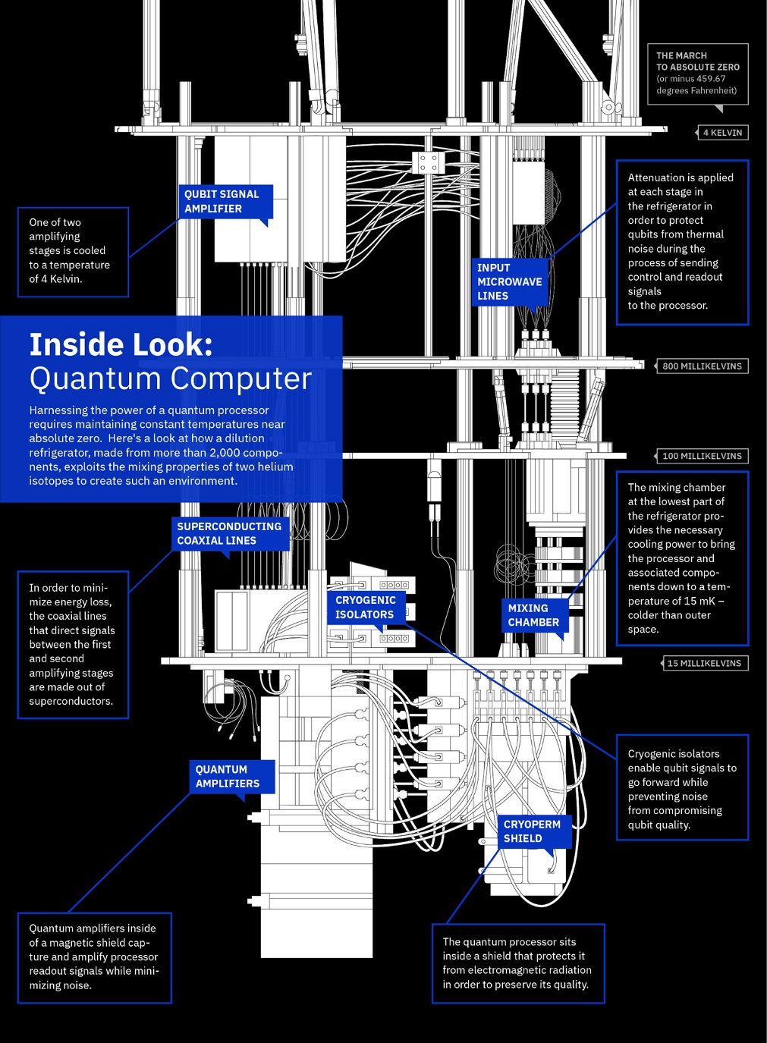
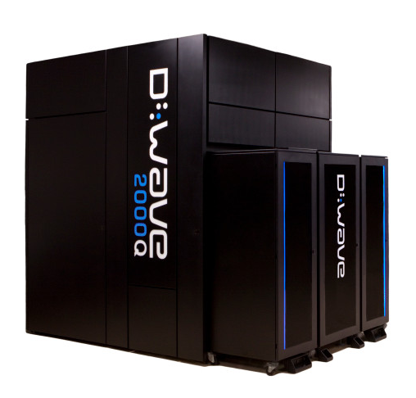
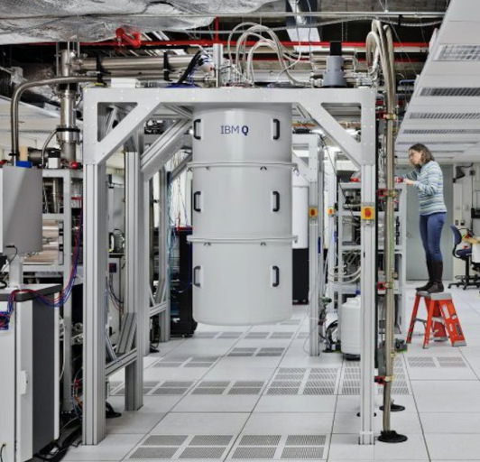
Hardware
D-Wave*
IBM Q
Microsoft: WIP | Google/Quantum AI Lab: WIP
Notes:
*D-Wave is very controversial among the physics community. This is not a true universal quantum computer.

Slide 17
Software – Programming Languages
QCL
First implemented imperative quantum programming language
Largely resembles C
Q
Second imperative language
Extension of C++
Q#
Developed by Microsoft in parallel to it’s hardware
Python / C / C++ / MATLAB and so on
Cloud based services providing quantum computing have APIs that will interface with client libraries
QISKit - dev kit for IBM Q
Notes:
https://en.wikipedia.org/wiki/Quantum_programming

Slide 18
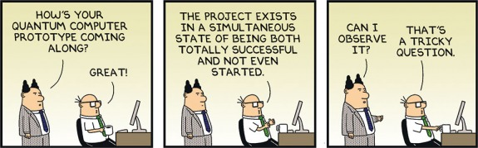
Practical Applications
Cryptographic Key Generation
Integer Factorization – Shor’s Algorithm
Unstructured Database Search – Grover’s Algorithm
Chemical & Molecular Simulations

Slide 19
Key Players
IBM
Google
Microsoft
Nokia Bell Labs (Yes, that Nokia)
D-Wave
Lockheed Martin
Raytheon
Notes:
https://edgylabs.com/11-companies-set-for-a-quantum-computing-leap

Slide 20
Live Example – IBM Cloud
Register for IBM Q at https://quantumexperience.ng.bluemix.net/qx
Download QISKIT for python and install libraries

Slide 21
Live Example – IBM Cloud
#Random Number Generator
import projectq.setups.ibm
from projectq.ops import H, Measure, CNOT
from projectq import MainEngine
from projectq.backends import IBMBackend
# create a main compiler engine using IBM Quantum Experience
eng = MainEngine(IBMBackend(use_hardware=True, num_runs=1024, verbose=True, device='ibmqx5', user=‘[user]'))
# allocate five qubits
q1 = eng.allocate_qubit()
# put qubits in superposition
H | q1
# measure quibits
Measure | q1
eng.flush()

Slide 22
Live Example – IBM Cloud
# Bell State & Entaglement
import projectq.setups.ibm
from projectq.ops import H, Measure, CNOT
from projectq import MainEngine
from projectq.backends import IBMBackend
# create a main compiler engine
eng = MainEngine(IBMBackend(use_hardware=True, num_runs=1024, verbose=True, device='ibmqx4', user=‘[user]'))
# allocate one qubit
q1 = eng.allocate_qubit()
q2 = eng.allocate_qubit()
# put it in superposition
H | q1
CNOT | (q1, q2)
# measure
Measure | q1
Measure | q2
eng.flush()

Slide 23
You Too Can Experiment!
IBM Q (Simulator & Hardware)
https://quantumexperience.ng.bluemix.net/qx
Microsoft (Simulator)
https://www.microsoft.com/en-us/quantum/development-kit
Quantum Playground (Simulator)
http://www.quantumplayground.net/#/home

Slide 24
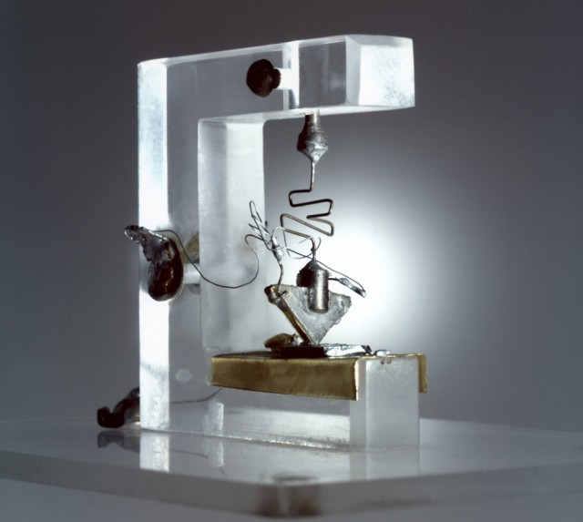
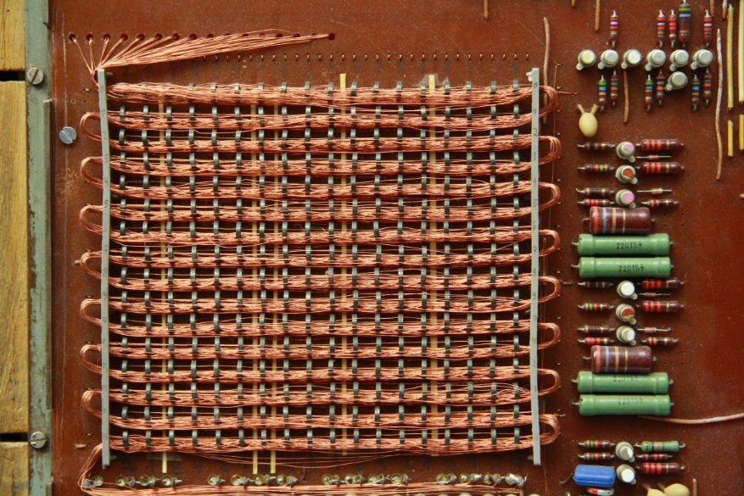
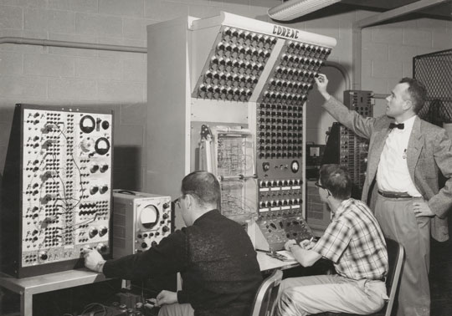
Takeaways - State of Quantum Computing
Through cloud platforms, the 1st generation of commercial quantum computers are becoming accessible to the general market. These are analogous to some of the first mainframe computers. This technology will be used to solve very specific problems and should not be considered a universal computing technology… yet. Today, applications are very limited, but researchers and technology companies are still discovering and inventing new ways to apply this technology to some of the most computationally intense problems. In addition, breakthroughs in hardware are needed to improve the capability & reliability of these devices. However, it is likely advances will be made quickly, and by the end of next decade it is possible that problems once though insolvable, will be routine.
Notes:
It

Slide 25
Additional Resources
edX – Quantum Mechanics for Everyone
https://www.edx.org/course/quantum-mechanics-everyone-georgetownx-phyx-008-01x
Michael Nielson – Quantum Computing for the Determined
https://www.youtube.com/user/mnielsencourses
Wikipedia
https://en.wikipedia.org/wiki/Quantum_computing
https://en.wikipedia.org/wiki/Quantum_logic_gate

